Slide 1
PBIS
Positive Behavior Intervention strategies
Mae Jemison

Slide 2
What is PBIS?
Positive Behavioral Interventions and Supports (PBIS) is an evidence based three-tiered framework to improve and integrate all of the data, systems and practices affecting student outcomes everyday. PBIS creates schools where all students succeed.

Slide 3
What are the goals of PBIS?
PBIS is founded on the idea that behavior can be taught and that all students do well when they are placed in a setting in which they can thrive. PBIS schools seek to focus on positive behaviors and create a consistent and predictable environment for students.

Slide 4
Why choose PBIS?
Data driven and Team Based
Consistent with research-based principles of behavior
Encourages the teaching and reinforcement of positive social expectations and behavior across all settings

Slide 5
What are the benefits of PBIS?
Improves school culture
Builds social skills
Reduces office discipline referrals
Reduces suspensions
Increases instructional time
Improves social and emotional development
Improves school safety
Increases student engagement
Improves academic performance
Increases family involvement
Improves faculty retention
Improves classroom management

Slide 6
What are the expectations of students?
Be Safe
1
Be Responsible
2
Be Respectful
3

Slide 7
How does PBIS include your child?
Developing positive and effective student behavior is a group effort where students, teachers, support staff, administration and parents/families work collaboratively towards achieving this goal.

Slide 8
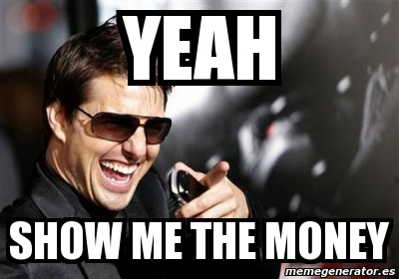

Slide 9
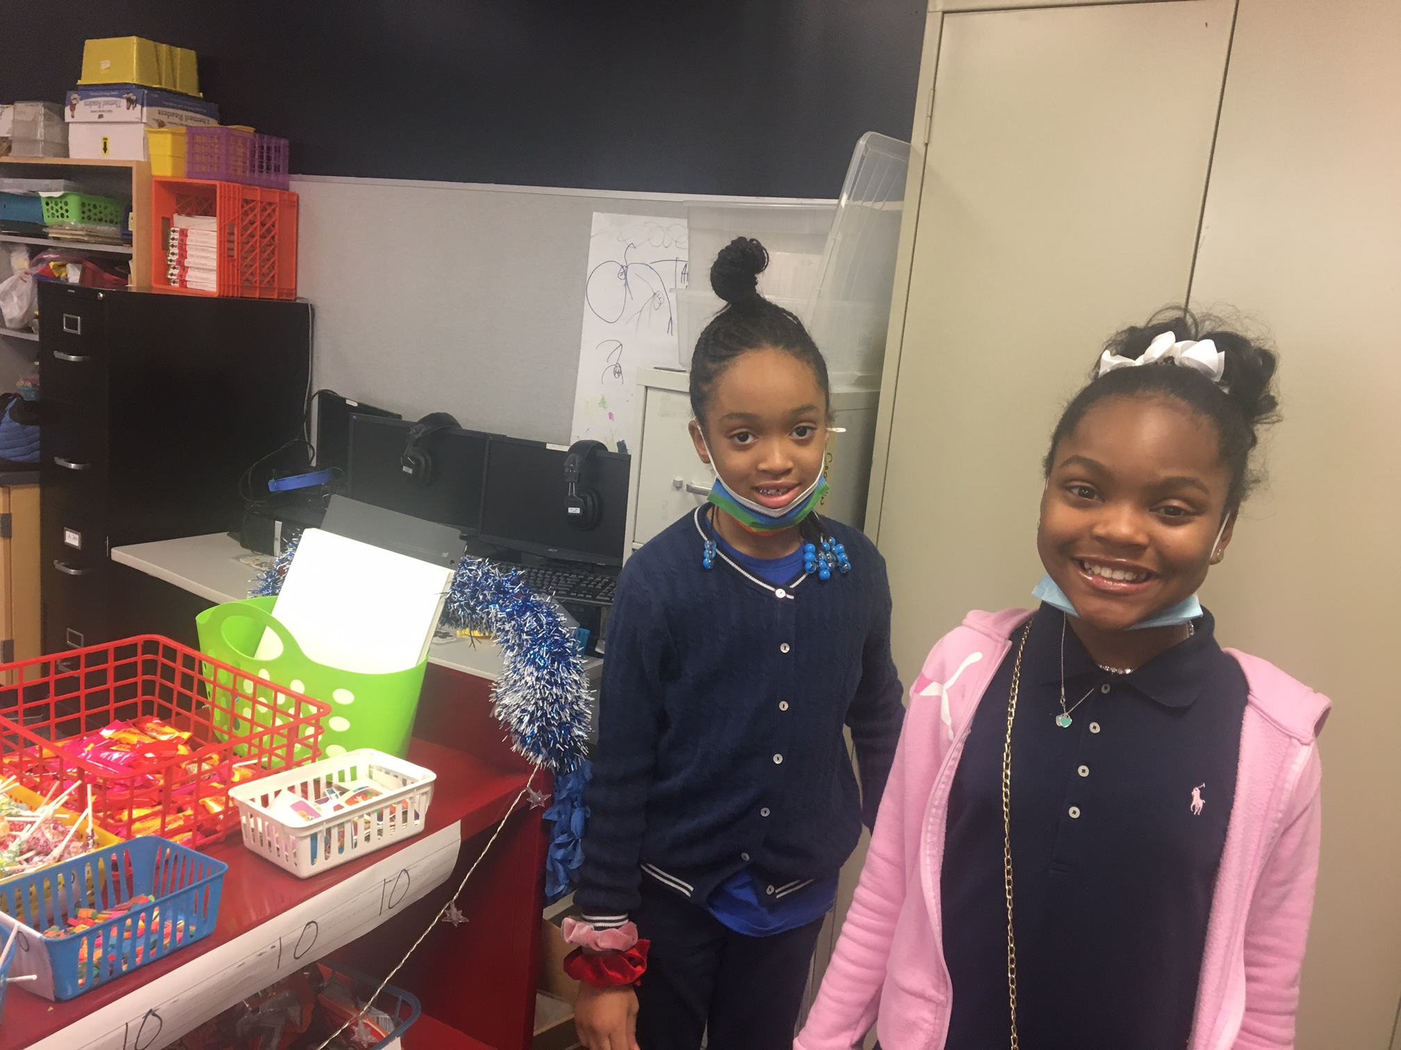
Moon Money
Distribute as a reward for being safe, responsible and respectfully
The Moon Cart has a variety items that the students can spend their Moon Money on.

Slide 10
PBIS fundraiser's
The moon cart is a benefit for all students. As a school we will have a variety of fundraisers to help support our PBIS program. The school is allotted a small number of funds to purchase items for the students that we use for our cart. We also have staff that donates to our cart.
As a school , we will use the donations for our Moon Cart and for our end of the year activities. Some of our fundraisers will include Sno Cone sales, cotton candy, fall ball and moon store. Please remember that the money raised helps our students!

Slide 11
PBIS at MJ
Fun Fridays
BINGO
Student of the month
Building incentives
Moon cart
Lunch Bunch
Bussin or Busted (bus behavior)

Slide 12
Questions, comments, concerns

